Slide 1



Trivox Assistant
PRESENTED TO
PRESENTED BY
Chandigarh University
Tripti Pandey
AI Voice-Controlled Phone
Your Phone, Your Voice, No Hands Needed!

Slide 2
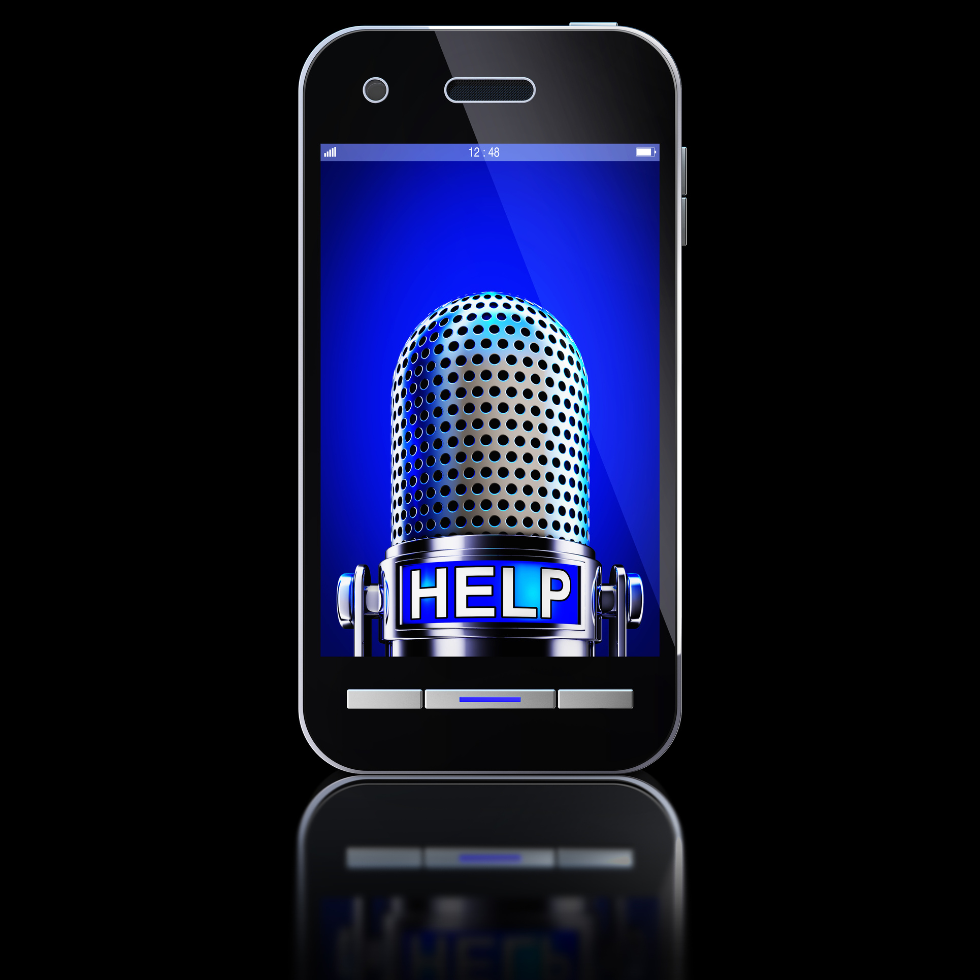



Current Challenges
Smartphones today are often inaccessible during everyday tasks, such as driving or cooking, leading to security risks from unauthorized access.

Slide 3



Unique Features
ZERO-TOUCH CONTROL
Make calls, take photos, and send messages using only your voice.
MILITARY-GRADE SECURITY
Auto-shutdown after failed attempts ensures your data remains safe.
CONTEXT-AWARE AI
Learns habits to enhance user experience with intelligent commands.

Slide 4


2
Lockdown Attempts
Code Efficiency
Maximum failed attempts allowed
Unlocking user-friendly, voice-controlled smartphone experience
100%
Voice Command Accuracy
Success rate of commands

Slide 5


Security Protocols Timeline
Key steps in our security approach
Attempt One
Attempt Two
Shutdown Trigger
Reboot Options
Warning issued for unauthorized access
Force shutdown initiated after second attempt
Device locks upon too many attempts
Options for reboot via hardware or voice

Slide 6







Trivox in Action: Voice Command Features

Slide 7

1,000,000
Potential User Base
Future Innovations
Projected downloads in 2025
Plans for iOS version and smart home integration
85%
User Satisfaction Rate
Anticipated positive feedback

Slide 8
500,000
Potential users impacted
Hands-Free Revolution
Assistive tech growth opportunity
Transforming technology for assistive convenience and security in daily life
95%
User satisfaction rate
Positive feedback on ease

